Slide 1

Learning Management System Project Presentation Date: 08/05/2024
Major Project (ICI651)
Degree : BCA
Project Guide:
Project Guide Name
Mr. Aditya Tripathi
Harshita Gupta (TCA2156031)
Ashish Sharma (TCA2156004)
Harsh Gaur (TCA2156010)
FACULTY OF ENGINEERING & COMPUTING SCIENCES
TEERTHANKER MAHAVEER UNIVERSITY, MORADABAD

Slide 2

Team Details
Student Name | Role
Harshita Gupta | Frontend
Ashish Sharma | Backend
Harsh Gaur | Testing
2

Slide 3
Project Brief
Project Title:
SLS: - Smart Learning Solution
Domain:
Digital Educational Website
Project Description
An Online Learning Management System (LMS) is a digital platform designed to help students and educators engage in learning activities remotely. It provides a central hub where students can access course materials, submit assignments, and interact with peers and instructors. Teachers can create and deliver lessons, track student progress, and assess performance. The LMS typically offers features such as video lectures, discussion forums, quizzes, and gradebooks. It aims to facilitate effective communication, streamline aministrative tasks, and enhance the overall learning experience in a virtual environment.
Problem Statement
An Online Learning Management System (LMS) is like a digital school.
It helps students and teachers to learn and teach over the internet.
Students can access lessons, videos, and assignments from anywhere, anytime. Teachers can create courses, share materials, and track students' progress.
LMS makes learning flexible, allowing students to study at their own pace.
It also promotes interaction through discussion forums and messaging.
With features like quizzes and grading, it assesses students' understanding. Overall, an LMS streamlines the learning process, making education more accessible and engaging for everyone involved.
3

Slide 4
Methodologies/ Technologies/ Tools to be used
Technologies to be used
Software Platform
Operating System Windows 10
Front End HTML, CSS, JavaScript,
Back End PHP
Library/ Framework Bootstrap
Code Editor Visual Studio Code 1.33
Database MySQL
Web Server Apache
Web Browser Google Chrome
2. Hardware Platform
Processor i5 Processor
RAM 8 GB
Disk Space 10 GB of Available Hard Disk
Display 1920 X 1080 or IPS Display
4

Slide 5
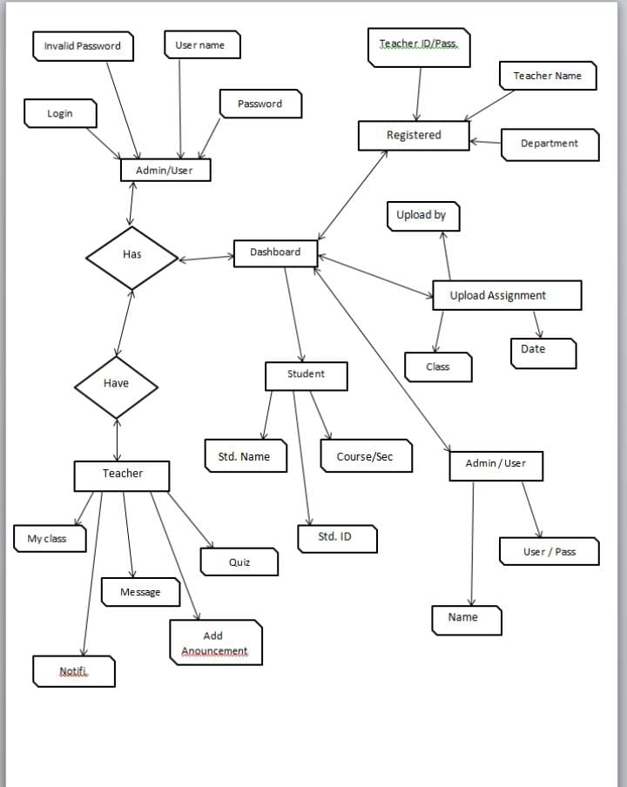
ERD Diagram
5

Slide 6
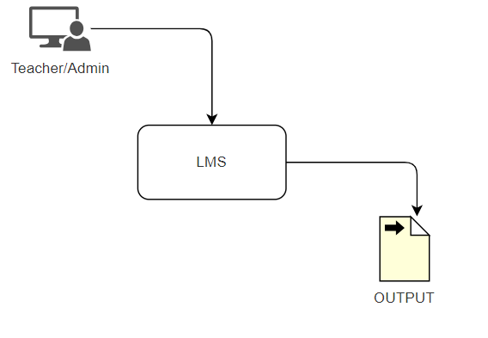
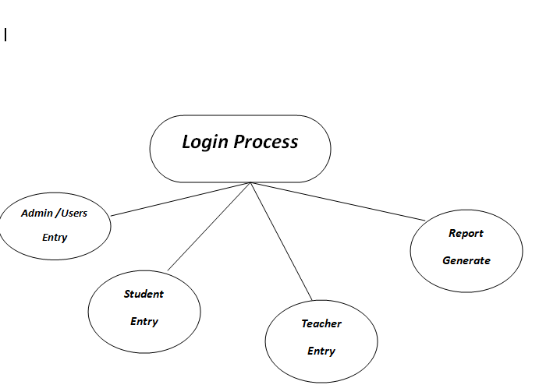
Data Flow Diagram (DFD)
:-
0-level DFD:-
1-level DFD:-
6

Slide 7
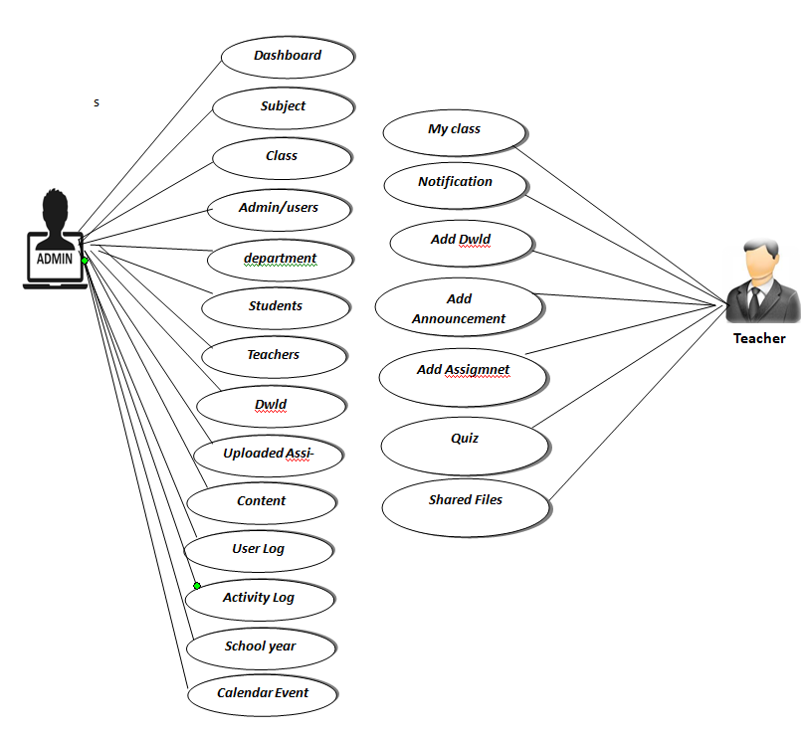
User Case Digram
7

Slide 8
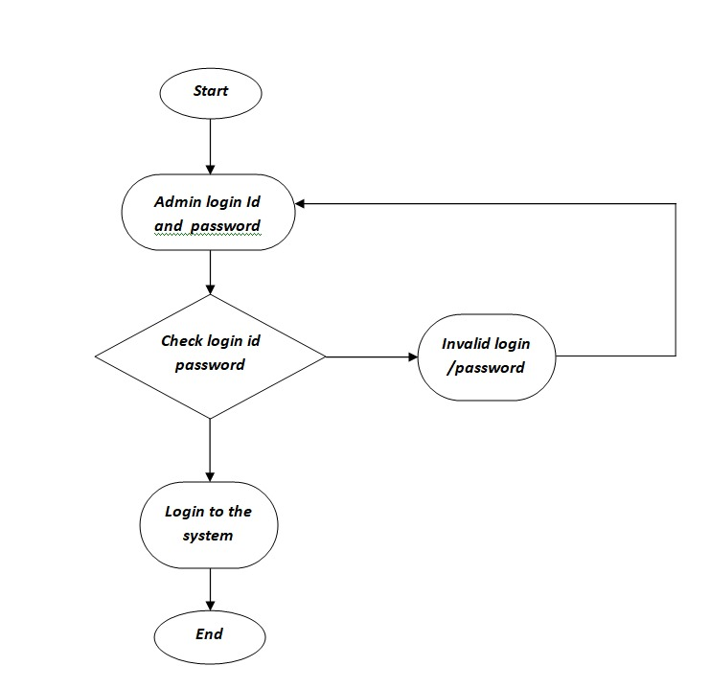
Flow Chart
8

Slide 9
Project Module
Project Modules
User Modules
Student Module
My class
Notification
Login/logout
Teacher Module
My class
Add announcement
Add assignment
Quiz
2. Admin Modules
Dashboard
Subject
Student
Teacher
Department
Logout
9

Slide 10
\
Advantage of The Project
Save time-: E-learning is self-directed, which means students can learn as and when it’s convenient for them, all easily and quickly accessible via an LMS. It also saves time for administrators organizing training courses.
Improves the student experience-: By ensuring all training courses and materials are located in one central location it improves the learning experience for students, meaning they’re far more likely to engage with and complete courses.
Enables diverse assessment options-: Assessment can take place online via multiple formats in an LMS. Short quizzes, multiple choice, questionnaires all provide the opportunity to deliver immediate feedback. Teachers can also reference an external site including video formats and apply questions or topics from that stimulus. Students have the option to upload their work in multiple formats including screencasts, podcasts or video.
Data-driven Insights-: With robust analytics capabilities, an LMS provides valuable insights into student progress, engagement levels, and learning patterns. Educators can use this data to identify areas for improvement, track student performance, and refine teaching strategies, ultimately enhancing the overall quality of education.
Communication:-: Online learning platforms facilitate easy communication between students and instructors through messaging systems, email, and discussion boards. This fosters collaboration and enables students to seek help when needed.
10

Slide 11
References
https://www.cae.net/lms-learning-platforms-advantages/..
https://www.bsetec.com/blog/scope-of-learning-management-in-future/
https://collegevidya.com/blog/what-is-learning-management-system/
https://www.techtarget.com/searchcio/definition/learning-management-system
https://www.techtarget.com/searchcio/definition/learning-management-system
https://www.capterra.com/learning-management-system-software/buyers-guide
11

Slide 12
THANKS

